Slide 1


In One Day Training Session with DataStax Enterprise
Marc Selwan
Solutions Engineer

Slide 2
In One (2 hour) Day Agenda
Hands on with the DataStax Family
Meet and greet with Cassandra
CQL – Speaking the language
Get to know the architecture
DSE Search
What’s so special about it?
Extending CQL capabilities
DSE Analytics
Spark Streaming - Bringing analytics to the real-time world
SparkSQL – A stranger in a strange land
How do you get started?
Helpful links and tutorials

Slide 3
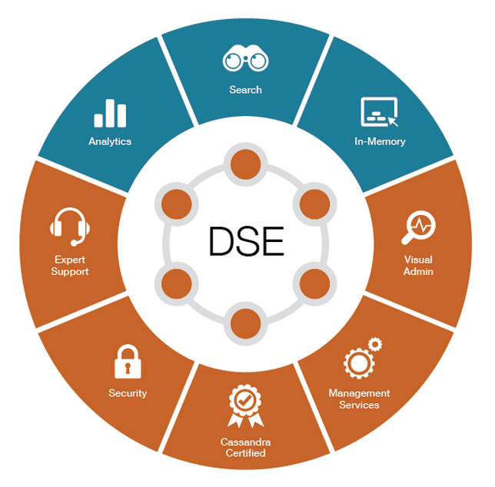
The DataStax Family

Slide 4
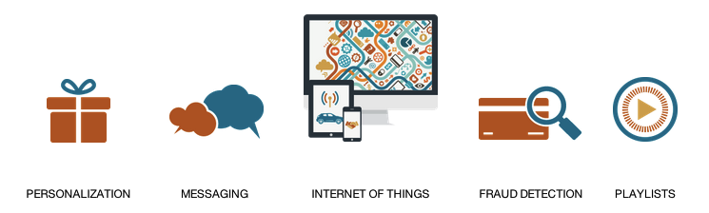
Common Use Cases
Notes:
NOTE: Our customer base is using C*/DSE in all sorts of amazing ways ... but we have narrowed it down to the top 5 most common so as they review their territory plan, they can start thinking about which use cases apply to their accounts.

Slide 5
Just to name a few…
Intuit uses Cassandra for session tracking, payment info/metadata
, user profiles & more.
Ebay uses Cassandra for product listings and personalization.
Best Buy uses Cassandra to store Customer 360 data.

Slide 6

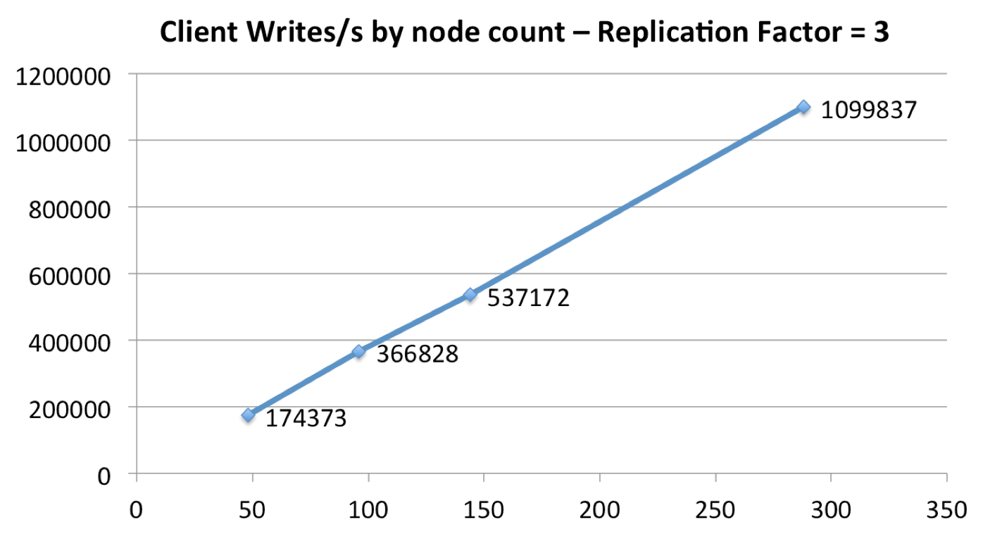
Why do people deploy this thing?
Always on
Simple and linear to scale

Slide 7
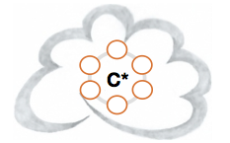
Why Apache Cassandra?
Open Source NoSQL Database
Industry Leading Performance
Predictable Scalability
Multi-Geo/Cloud Data Distribution
Operationally Simple
Dynamic Data Model
SQL-Like API (CQL)
C*
C*
San Francisco
New York
C*
Stockholm

Slide 8
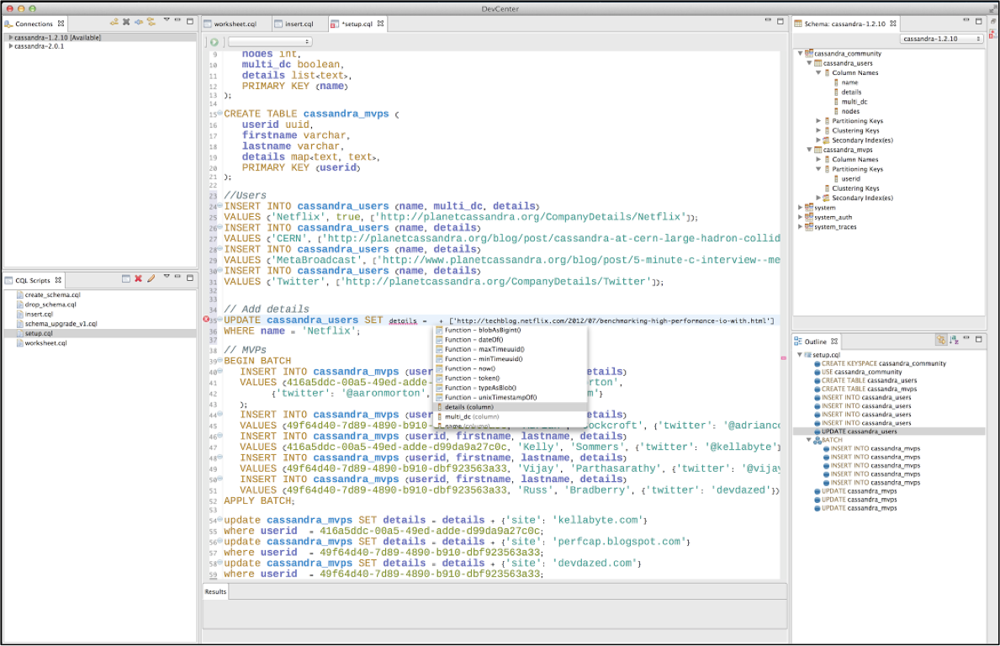
Speaking Her Language

Slide 9
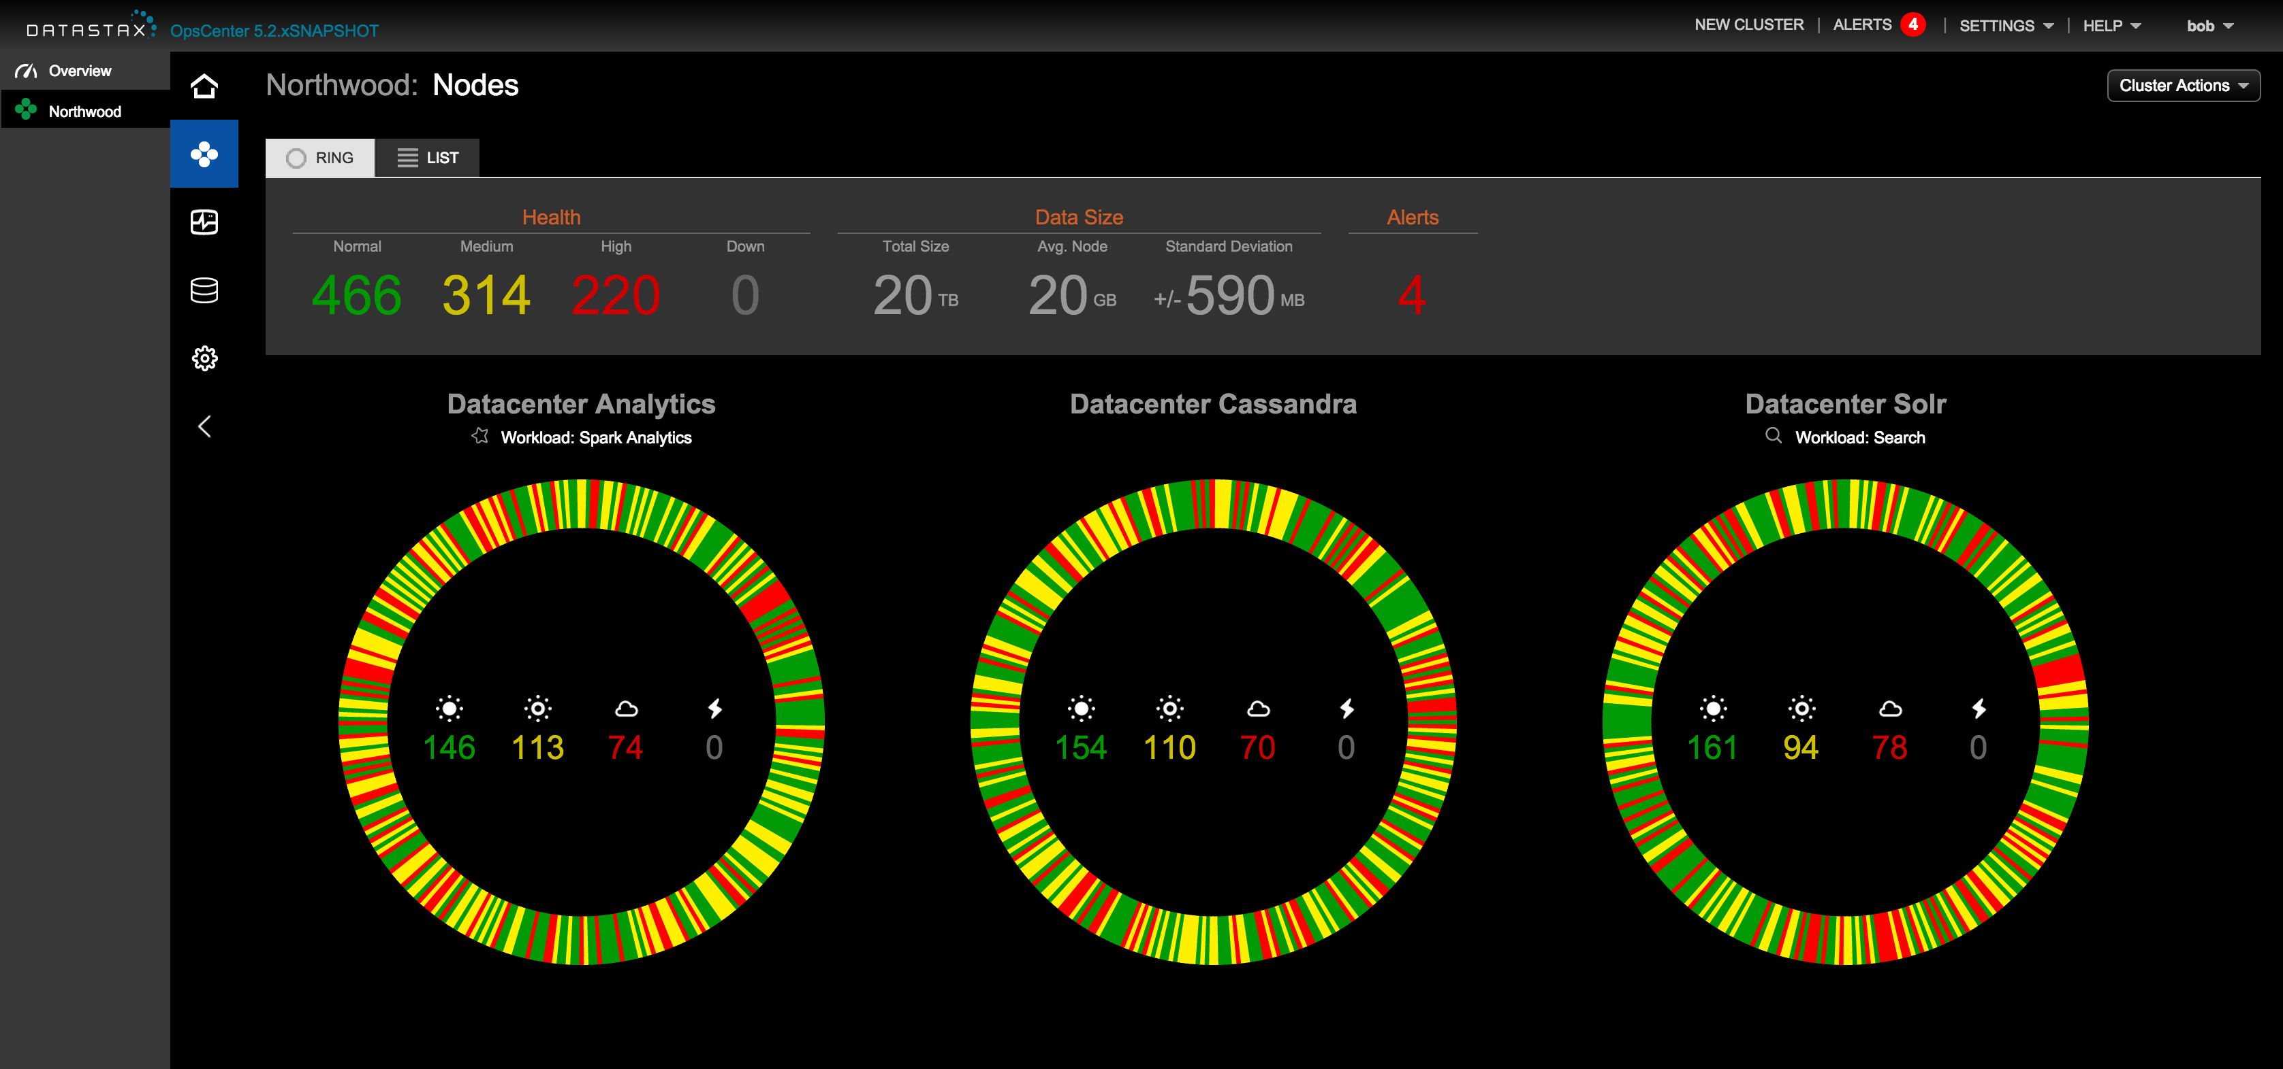
Let’s Explore DSE OpsCenter
http://iodtdatastax.westus.cloudapp.azure.com:8888/opscenter/index.html

Slide 10
Getting to know DSE
Dsetool – The main cammand line tool for DataStax
dsetool ring – Get even more info about our cluster
Let’s warm Cassandra up!
cassandra-stress write
cassandra-stress read
How did she do?

Slide 11
Getting to know Cassandra Query Language
CQLSH – CLI for Cassandra Query
cqlsh
Keyspace – Where your column families live
CREATE KEYSPACE <your name here> WITH replication = {'class': 'SimpleStrategy' , 'replication_factor': 3};
Column Family – Your data tables
CREATE TABLE <your keyspace>.holiday_wishlist ( name text, product text, url text, price double, PRIMARY KEY(name, product));

Slide 12
Inserting Data Into Cassandra
Let’s fill in our holiday wishlists:
INSERT INTO marcselwan.holiday_wishlist (name, product, url, price) VALUES ( 'rachel', 'canon 5d mark iii', 'www.adorama.com', 2500.00);
INSERT INTO marcselwan.holiday_wishlist (name, product, url, price) VALUES ( 'rachel', ‘fitbit charge', 'www.amazon.com', 175.00);
INSERT INTO marcselwan.holiday_wishlist (name, product, url, price) VALUES ( 'rachel', ‘apple watch sport', 'www.apple.com', 350.00);
Let’s get our lists back:
SELECT * FROM marcselwan.holiday_wishlist WHERE name=‘rachel’;
SELECT * FROM marcselwan.holiday_wishlist WHERE name=‘rachel’ AND product=‘canon 5d mark iii’;
Next let’s explore what’s happening behind the scenes

Slide 13
SSH into the Class Cluster
ssh datastax@137.135.51.61
Password: C@ssandra
From here, you can ssh into any of the 12 nodes
ssh datastax@10.0.0.6 (7,8,9…17)
Password: C@ssandra
Create your keyspace with RF=3 and then create a table
cqlsh 10.0.0.6 (7,8,9…17)
OpsCenter URL: http://msfttrainingday.westus.cloudapp.azure.com:8888/opscenter/index.html
Notes:
cassandra-stress write n=1000000 -node 10.0.0.8
cassandra-stress read n=1000000 -node 10.0.0.7

Slide 14
Inserting Data Into Cassandra
Let’s fill in our holiday wishlists:
INSERT INTO marcselwan.holiday_wishlist (name, product, url, price) VALUES ( 'rachel', 'canon 5d mark iii', 'www.adorama.com', 2500.00);
INSERT INTO marcselwan.holiday_wishlist (name, product, url, price) VALUES ( 'rachel', ‘fitbit charge', 'www.amazon.com', 175.00);
INSERT INTO marcselwan.holiday_wishlist (name, product, url, price) VALUES ( 'rachel', ‘apple watch sport', 'www.apple.com', 350.00);
Let’s get our lists back:
SELECT * FROM marcselwan.holiday_wishlist WHERE name=‘rachel’;
SELECT * FROM marcselwan.holiday_wishlist WHERE name=‘rachel’ AND product=‘canon 5d mark iii’;
Next let’s explore what’s happening behind the scenes

Slide 15
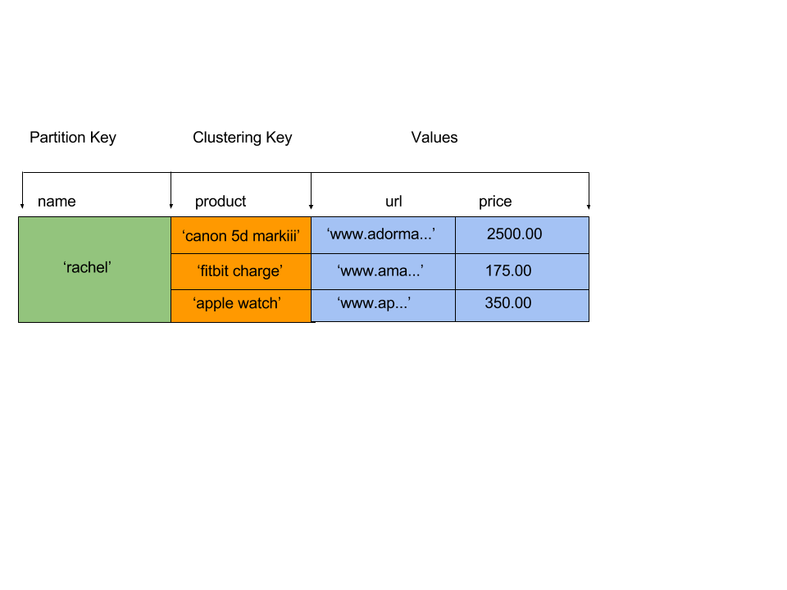
CQL Storage Engine
PRIMARY KEY( name, product)
Partition key is part of the unique identifier – this is what gets hashed.
Clustering Key = dynamic column. The values become new columns growing your tables horizontally.
You can sort and do range scans on Clustering Keys

Slide 16
Where’s your write going?
read
write
data tables
Write hits memory and a commit log for durability
One memtables are full, it gets flushed to disk as an ‘sstable’
Compaction merges sstables on disk to improve read performance
memory
disk or SSD
data tables

Slide 17
Look Mom! No hands!
Client
Token | Order_id | Qty | Sale
70 | 1001 | 10 | 100
44 | 1002 | 5 | 50
15 | 1003 | 30 | 200
10
Node failure or it goes down temporarily
80
20
Client
70
30
We could still retrieve the data from the other 2 nodes
60
40
50
Replication Factor = 3
Notes:
Always on:
Peer to peer architecture – all nodes are equal; each node is responsible for an assigned range (or ranges) of data
Clients can write (or read0 data to any node in the ring – native drivers can round robin across a DC and distribute load to a coordinator node
Coordinate node writes (or reads) copies of data to nodes which own each copy
In the case of a failure (such as a drive going down),
2 out of the 3 nodes are still on, so the ability to write and read data still works for the majority of nodes and therefore C* is always on

Slide 18
The “C” word.
Replication Factor (RF) = Total number of copies of a respective row
Consistency Level (CL) = How many nodes acknowledge a request
“But Marc…What about consistency!?”

Slide 19
The more you know
Replication happens in real time -It’s as fast as your network is
Cassandra has built in anti-entropy mechanisms
Repair, hints, read repairs
Tunable Consistency
W.CL + R.CL > RF = fully consistent

Slide 20
Out-of-the-box multi data center support
Client
No interruption to the business
10
15
10
80
20
85
25
80
20
Client
75
35
70
Data Center Outage Occurs
30
70
30
60
65
45
60
40
40
50
55
50
West Data Center
East Data Center
Notes:
Multi-DC is very, very easy to configure with Cassandra
Datacenters are active – active: write to either DC and the other one will get a copy
In the case of a datacenter outage, applications can carry on a retry policy which flips over to the other datacenter which also has a copy of the data;
Outbrain story – Hurricane Sandy

Slide 21
Let’s Play With Consistency in the Shared Cluster
In CQLSH:
TRACING ON
CONSISTENCY ALL
Run a query – How fast did it complete?
CONSISTENCY LOCAL_ONE
Run a query again – Now how fast did it complete?
Let’s start taking down nodes:
service dse stop
Or we can use OpsCenter!
Now change consistency and try queries at different levels: ALL, LOCAL_QUORUM, LOCAL_ONE

Slide 22
Let’s Explore DSE Search
“I want to search by more indexes!”
“Sometimes I don’t know what I’m searching for…”
“I want to simplify my stack and eliminate the need for another data store.”
C* & Solr
C* & Solr
C* & Solr
C* & Solr
No ETL
Automatic indexing of data
Fuzzy, faceted, geospatial, and text
searches on Cassandra data
Cassandra benefits (scaling, availability)
Solr embedded in CQL!
Easy to get started

Slide 23
Performance or functionality…it’s your choice
**Denormalize and use CQL when you can first

Slide 24
Indexing the Data for Search
Create the Solr Core
dsetool create_core <your keyspace>.<your table> generateResources=true reindex=true
Let’s do some searching:
SELECT * FROM marcselwan.holiday_wishlist WHERE solr_query=‘{“q”:”column:*”}’;
SELECT * FROM marcselwan.holiday_wishlist WHERE solr_query='{"q":”name:rachel", "fq":”url:*ador*", "sort":”product:asc"}’;
Some of the types of searches you can do:
q:
fq:
facet:
!join:
!geofilt
sort
AND/OR

Slide 25
Queries
“q”: for general queries. Used for fuzzy searches. You can use ‘*’ for fuzzy searches
Example: “q”: “title:Noir*”
“Give me all the titles that contain “Noir”
“fq”: for more specific searches. Filtered items are cached for extra performance!
Example: “fq”: “categories:horror
“Filter by the categories that are “horror”

Slide 26
Facets and Joins
“facet”: For finding the occurrences of things related to your queries
Example: “facet”: {“field: “categories ”}
“What categories contain ‘X’?”
“!join”: For filtering based on indexes of another table. Must have the same partition keys!
Example: “"fq":"{!join from=asin to=asin force=true fromIndex=amazon.clicks}country:US”
“Filter by the country field from the table clicks where country=US”

Slide 27
Geospatial
“!geofilt”: For finding differences in distances.
Example: "fq":"+{!geofilt pt=\"37.7484,-122.4156\" sfield=location d=1}"}
“Filter all results within a 1KM diameter from X location
Now is the time to run create_core.sh
Let’s jump into the Solr UI and see what’s happening.

Slide 28
Let’s kick it up a notch
You can’t manually insert data enough to make this interesting

Slide 29
Amazon Clickstream Data
Tables:
metadata: contains raw data including ‘also bought’ and categories’ and ‘price’
clicks: contains clickstream data including location information
SELECT * FROM amazon.metadata WHERE solr_query='{"q":"title:Noir~", "fq":"categories:Books", "sort":"title asc"}' limit 10;
SELECT * FROM amazon.metadata WHERE solr_query='{"q":"title:Noir~", "facet":{"field":"categories"}}' limit 10;
SELECT * FROM amazon.clicks WHERE solr_query='{"q":"asin:*", "fq":"+{!geofilt pt=\"37.7484,-122.4156\" sfield=location d=1}"}' limit 10;
SELECT * FROM amazon.metadata WHERE solr_query='{"q":"*:*", "fq":"{!join from=asin to=asin force=true fromIndex=amazon.clicks}area_code:415"}' limit 5;
SELECT * FROM amazon.metadata WHERE solr_query='{"q":"*:*", "facet":{"field":"categories"}, "fq":"{!join from=asin to=asin force=true fromIndex=amazon.clicks}area_code:415"}' limit 5;

Slide 30
We’ve got Spark, too!
“I want to do processing on data before it hits Cassandra.”
“I need my sums, avgs, group by’s ETC.”
“I want to run real-time analytics on my Cassandra data.”
C* & Spark
C* & Spark
C* & Spark
C* & Spark
No ETL
Cache datasets in memory – Fast!
Automatic leader/worker election
Very developer friendly
Stream processing
Cassandra benefits (scaling, availability)

Slide 31
Familiar Territory
Let’s play with some SparkSQL
dse spark --conf spark.ui.port=<number> --conf spark.cores.max=2
Try some of those CQL commands you learned earlier
use <your keysapce>;
SELECT * FROM <your table>;
SELECT * FROM <your table> WHERE…;
Notice any differences?

Slide 32
Now let’s explore
use amazon;
SELECT sum(price) FROM metadata;
SELECT m.title, c.city FROM metadata m JOIN clicks c ON m.asin=c.asin;
SELECT asin, sum(price) AS max_price FROM metadata GROUP BY asin ORDER BY max_price DESC limit 1;
Notes:
SELECT m.title, c.city FROM metadata m JOIN clicks c ON m.asin=c.asin;

Slide 33
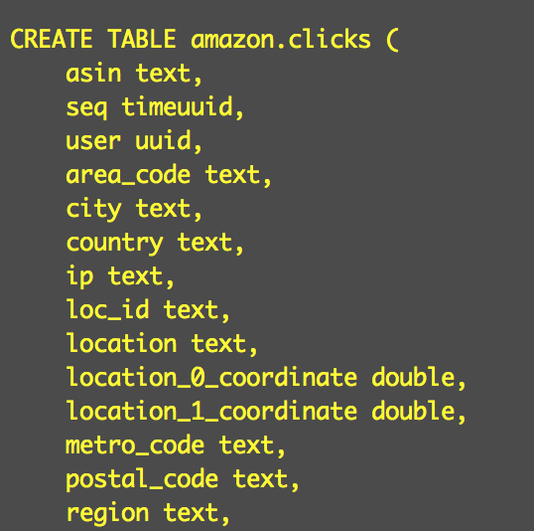
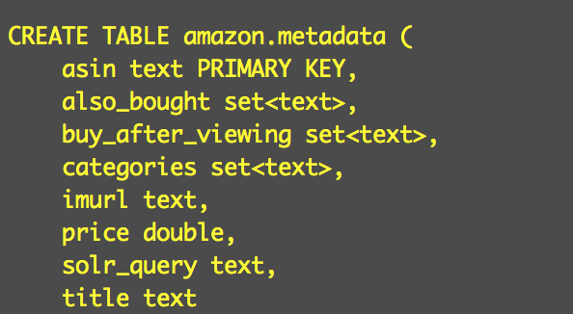
Let’s see what you come up with
https://docs.datastax.com/en/datastax_enterprise/4.8/datastax_enterprise/spark/sparkSqlSupportedSyntax.html

Slide 34
Let’s make a simple Keyspace and table
Open up cqlsh
cqlsh 10.0.0.6 (7,8,9…17)
CREATE KEYSPACE IF NOT EXISTS streaming_test WITH REPLICATION = {'class': 'SimpleStrategy', 'replication_factor': 3 };
use streaming_test;
CREATE TABLE IF NOT EXISTS words_table (word TEXT PRIMARY KEY, count COUNTER);

Slide 35
Simple Spark Streaming
Let’s open the spark REPL with the command:
dse spark --conf spark.ui.port=<number> spark.cores.max=2
Open a second terminal and enter:
nc -lk 9999
This starts a simple client that allows you to send messages to port 9999.

Slide 36
In the Spark REPL run:
Go to this link and copy the code:
https://github.com/Marcinthecloud/SimpleSparkStreaming/blob/master/README.md

Slide 37
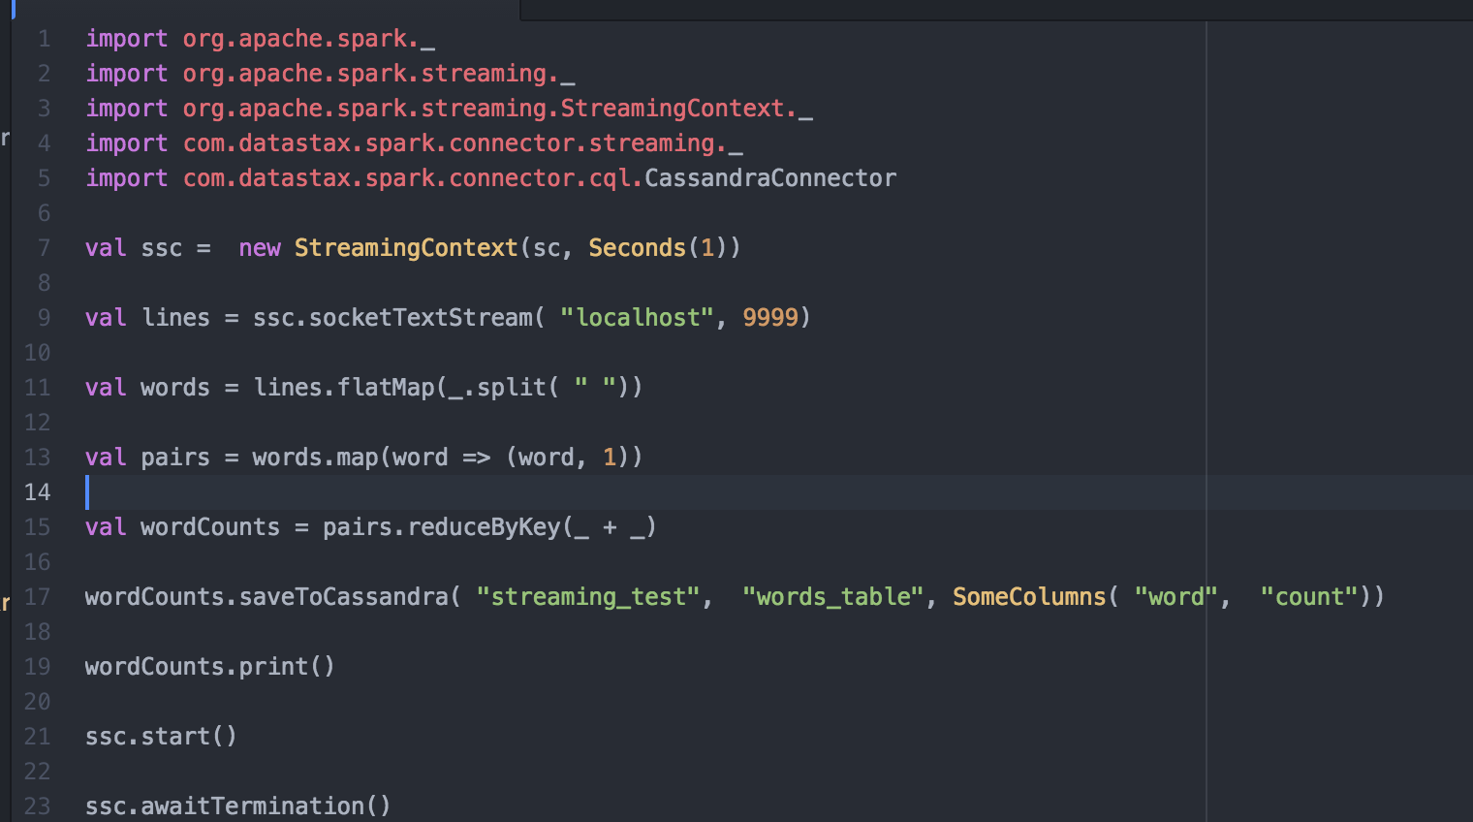
A formatted view that’s easy on the eyes

Slide 38
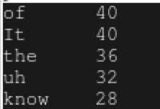
In the terminal with nc running…
Find bits of text on the net and paste it in the terminal.
I chose Taylor Swift lyrics … the top 5 results were…

Slide 39
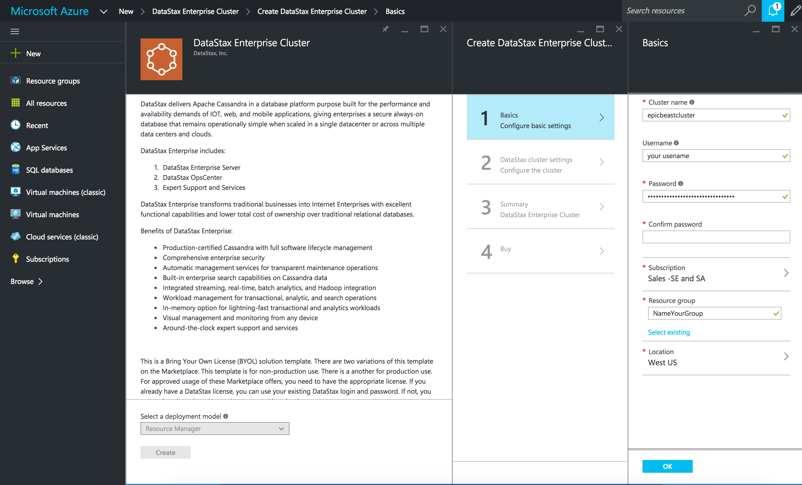
If you want to do this at Scale…
Here’s how to spin up an Azure cluster to play with:

Slide 40
I know you can’t wait to try more…
You’re going to see a lot of this guy
www.academy.datastax.com
Hands on tutorials
Free instructor lead training
Everything you need to get started
Try this at home: https://github.com/Marcinthecloud/Solr-Amazon-Book-Demo
Azure Marketplace Tutorial: https://www.youtube.com/watch?v=tmXdSEMjwCE
For Spark at Scale see: https://github.com/retroryan/SparkAtScale

Slide 41
Thanks!
For question email marc.selwan@datastax.com

